Slide 1

Using Person Centered Planning to Support Holistic Outcomes Across Employment and Non-Work
Phase 2024

Slide 2

Employment is Everyone's Job
We can, and should, support people wherever they are on their path to employment, no matter what service the person receives
Adopting Employment First values as an organization
Expecting employment as an outcome for people of working age
Keeping employment exploration at the forefront
Supporting community life engagement outcomes (instead of “outings”)
Holistically and strategically supporting people & teams

Slide 3
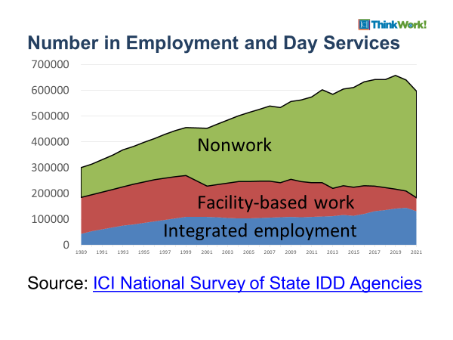
Number in Employment and Day services 1989 through 2021
Most people are here!
So, what are we doing?

Slide 4
10 Essential Elements of Provider Transformation
Focus and Values
Clear and consistent goals
Agency culture supports inclusion
Community Life Engagement & Employment Consultant Practices
Customer focus & engagement
A holistic approach
Active person-centered job development
Infrastructure
Reallocated, restructured resources
Strong communication plan
Ongoing staff development
Performance measurement & QA
Diverse community partnerships
https://act.thinkwork.org/about.html
Notes:
Staci

Slide 5
Employment Practices
Comprehensive, community-based, person-centered and time-limited discovery
Zero exclusion
Build relationships & skills
Work directly with local employers to develop jobs that meet a person’s ideal conditions for employment
Active, Individualized Job Placement Process
One person at a time

Slide 6
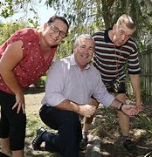
Non-Work: Community Life Engagement (CLE)
All the ways that people with I/DD access and participate in their communities, outside of employment, as part of a meaningful life.
Not a program, these are outcomes
Non-work
Accessing typical community facilities (library, faith community, gym, rec center, etc.)
Volunteerism
Post-secondary &/or continuing education
Wrap-around to work
Retirement activities
A Pathway to work for people of working age...

Slide 7


Using CLE as pathway to employment
Remember 'non-work mountain'
Raise expectations
CLE Guideposts
  Research based
  Quality indicators
  Framework of key principles
  Lead to and/or compliment employment
  Not a program
www.CLEtoolkit.communityinclusion.org
Notes:
Brian

Slide 8




CLE Guideposts of Support
1
Individualize supports for each person.
2
Promote community membership and contribution.
3
Build skills and facilitate relationships.
4
Ensure that supports are outcome-oriented and monitored.

Slide 9
Person Centered Thinking & Planning
Tools and Strategies

Slide 10

Person-Centered Thinking
Set of principles and approaches that prioritize a person's unique interests and needs that emphasize:
  self determination
  discovering what is important to people
  informed choice
  flexibility
  dignity and respect
  leading to better outcomes and quality of life
Person Centered Planning Principles - National Environmental Scan (acl.gov)

Slide 11
Person-Centered Planning
An evidence-based practice
A flexible set of approaches, tools and principles used for life planning
Strength based vs deficit based
WITH people not FOR people
Originally developed to support people leaving institutions
Note: Conflict-free case management
The Pioneers of Person Centred Planning - YouTube
Person Centered Planning Principles - National Environmental Scan (acl.gov)
Notes:
by a small group of people, including John O'Brien, Connie Lyle O'Brien, Beth Mount, Michael Smull and others

Slide 12
Person-Centered Planning in MN
"Formal person-centered planning will seek to:
Understand who a person is
Establish and support a personal vision
Work to build community supports and actions on behalf of a person in achieving that vision"
Notes:
by a small group of people, including John O'Brien, Connie Lyle O'Brien, Beth Mount, Michael Smull and others

Slide 13

Person Centered Planning and learning about people must be baked into service delivery & the culture
MTI CLE CoP: Culture

Slide 14

Discovery
What about Community Life?
Identifies ideal conditions of employment
No one can ‘fail’ Discovery
Completed by someone trained in Discovery
Full engagement with the person and support team
Assumes everyone can work
Job Development immediately follows Discovery
How could Discovery support your Day Services?
How might you partner with Employment staff?
How could Discovery support people who are underemployed?

Slide 15
Small (d) discovery/exploration
Can be baked into non-work services
Can be used when Discovery is not available yet
Can be done in small, intentional groups
May be led by the person’s interests
Happens in typical community settings
Get new experiences
Build new connections
Learn new skills (example: get lost on purpose)
Fold the information we learn back into the service delivery

Slide 16
How is info best learned and collected?
  One-on-one interviews with the person
    What might we miss if we ONLY do this?)
  Observe the person in various community-based settings/activities
    Don't make assumptions based on center-based history
  Interview people that know the person well
  Interview people the person trusts
  Observe at home (when possible/practical)
  File review and Individual Support Plan:
    What might be here? What might not be?
Microsoft Word - Developing a Positive Personal Profile G Tilson.docx (dc.gov)
Notes:
What are the ways you currently get to know people you're supporting?
Are there things you might not know enough about the person?

Slide 17
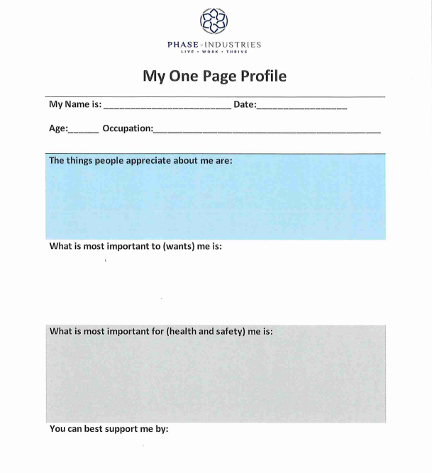
One Page Profiles
What's
YOUR current process?
Notes:
How often are DSPs updating? When, how?
Does the info MATCH what's in the PCP? If no, why not?

Slide 18

What ELSE are you paying attention to?
  Everything!! (behavior is communication)
    Setting/environment
    Time of year
    Who else is around (??)
    Relationships
    Interests
    Mood
    Health
    Weather
10 Things: David Pitonyak
Notes:
Sean- he wants a job like Jason
James- hurricane katrina

Slide 19
Language Matters
Use positive and person first language (not program language)
Be specific and clear
Be thorough
Focus on HOW to support people
Focus on outcomes (employment and community life engagement)
Update with new info

Slide 20
Language Matters
Example in positive profile:
John has behaviors when things don’t go his way.
What do you think about John when you read this?
How might DSPs treat John?
Do you know how to support John?
What don’t you know?

Slide 21
Language Matters
Example: John has behaviors when things don’t go his way.
Vs.
In order for John to be successfully supported to participate regularly in work and community activities, it is important that he participate in the development of his schedule ahead of time and be made aware of changes as soon as possible.
A schedule should be planned with John weekly by showing him pictures of what activities he may be interested in and helping him to choose which he prefers. Once the schedule is established, a copy of the picture schedule should be printed and provided to him so he can refer to it regularly.
If there needs to be a change in schedule, this should be shared with John as soon as possible, along with an updated picture schedule. This allows time for John to process and express his concerns about the changes. John likes to talk to his family on the phone in the evenings and them knowing John’s schedule allows additional opportunity for the schedule to be reinforced with John. If changes are made, let them know as well, so they can support these changes.

Slide 22

Be Specific!
Most people like music, animals and food

Slide 23
Example of feedback loop or quality cycle
Learn new things about people
Update profiles
Adjust services/supports
Inform plan, outcomes, goals
Use services to support outcomes and goals
Track progress/data
Services are dynamic, responsive and evolving based on new information and data

Slide 24
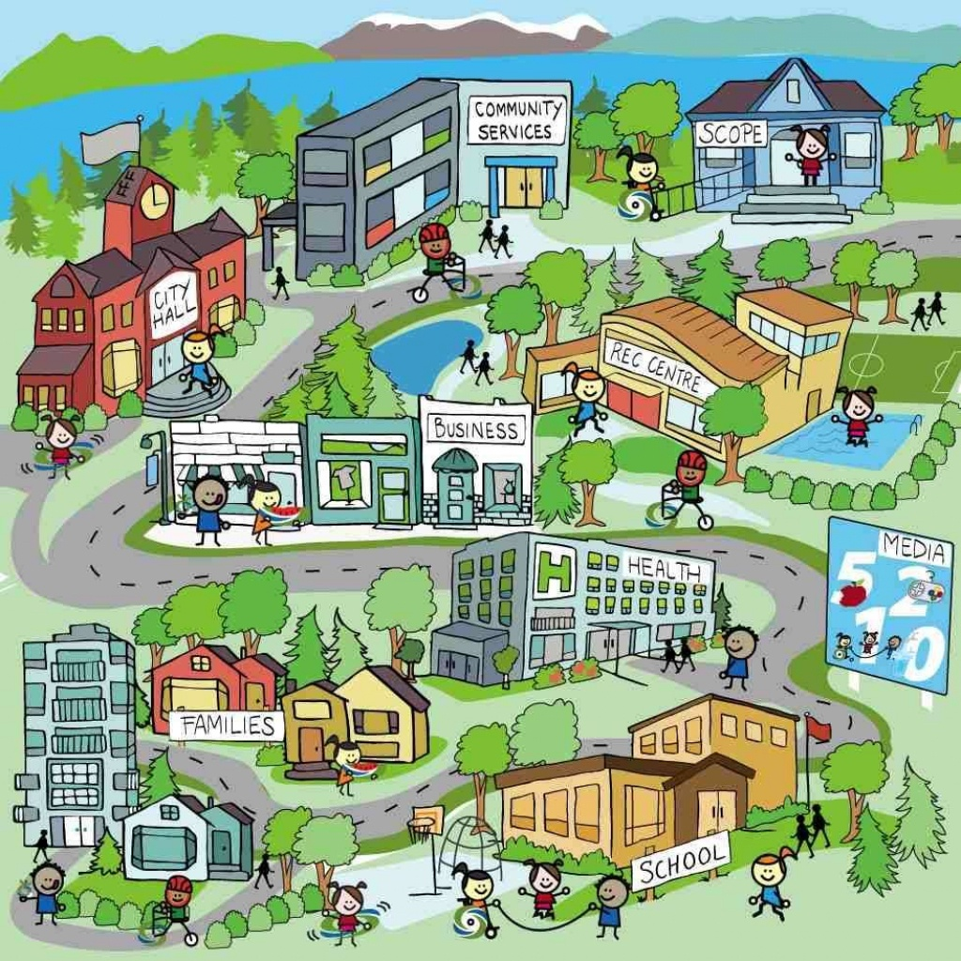
Are you mapping your community?
Create a map of community assets and resources within a defined area
Demographics
Highlight people, places, organizations, and institutions
Walk and/drive around (don't just google...why not?)
Be curious!!!
  Don't know what goes on there and why? Find out!
Mapping Relationships – LifeCourse Nexus (lifecoursetools.com)
Notes:
Collecting data in order to create a map of community assets and resources within a defined area. A community map or catalog can highlight people, places, organizations, and institutions that can be utilized to create a meaningful life.

Slide 25
Are you mapping your community?
Who is doing this?
Where/how is info housed?
Who uses the info and how? Who updates it?
BOD, staff networks, families, employers can help broaden your scope
Example Spreadsheet
Name of business, organization or community location | Address | Type of business, organization or community location | Days/hours open to the public | Why do people go here? What do they do? | Important things to know about this local? | Contact person(s) | Other important info?
Mapping Relationships – LifeCourse Nexus (lifecoursetools.com)
Notes:
Collecting data in order to create a map of community assets and resources within a defined area. A community map or catalog can highlight people, places, organizations, and institutions that can be utilized to create a meaningful life.

Slide 26
Cultural Competency & Humility
Ensuring the organization and staff are culturally self-aware
  Aware of biases that have been 'baked in'
Understand the demographics of your organization, communities
Be intentional about outreach
Build trust
Emphasize collaboration and peer-to-peer approaches

Slide 27
How do we use the information? Work WITH the person to:
  Develop schedules
  Identify support needs
  Identify appropriate matching
  Identify desired/needed goals and skills
  Identify ideas for jobs, volunteerism, social roles, experiences, community membership and relationships
  Identify gaps
  Explore possibilities
  Notice contradictions
  Continually update

Slide 28

Three Cups of Tea
Greg Mortensen
Notes:
Next we're going to talk about the art of networking. Building your network and creating opportunities for the people you support is crucial to their success in building a good life.
Talk about the book and the controversy

Slide 29
The first time you share tea with a Balti, you are a stranger. The second time, you are an honored guest. The third time, you become family.
-Balti proverb (Northern Pakistan): Greg Mortensen, Three Cups of Tea

Slide 30

Three Cups of Tea
Take time to get to initially get to know the person, listen and ask questions, you’re learning about their business or organization here. FIRST CUP OF TEA
Offer them something useful: Share an article you found that may be helpful, connect them with another of your contacts, etc. This is about building trust. SECOND CUP OF TEA
Make “the ask”. If they can’t give it to you, ask them to make a recommendation of someone who could help, or ask if you can add them to your “experts” list. THIRD CUP OF TEA

Slide 31

First Cup of Tea
Make Your Opening, speak with someone who makes hiring decisions and Secure a Follow-up
Notes:
Practice your opening: “Hello my name is, Amy I’m an Employment Specialist at PHASE-Industries. I help people who want to work find jobs. Tell me about your business AND Could I set up a time to come back for about 15 minutes and learn more about your business? What day/time works best for you?”
Your goal is to get to speak with someone who can make hiring decisions. Ideally, you’ve researched the company(ies) that are there and know who you’re looking for. You should have a list of questions. The goal here is to have a conversation where they do most of the talking.
If you can’t have a full conversation here to learn more about their business/organization, set up the follow-up to get your cup of tea.

Slide 32


Slide 33

Second Cup of Tea
Follow-Up &/or Offer them something helpful.
Build Trust and ask for a tour of their business.
Notes:
Here’s this great resource I found, or this product flyer, or this interesting person I met that may have the same interests as you/be able to help you. AND THEN I really appreciated getting to know a little bit about your business, would I be able to come in and tour to get a better understanding of what you do? Again, you’re listening and looking here. What are the jobs that aren’t getting done, what are the things keeping them up at night. What can they use help with?
Can I come by and tour your business so I can learn a little bit more about it?

Slide 34

Third Cup of Tea
Make the “Ask.”
Notes:
I saw you have XYZ that is bogging down some of your staff, I have this person who is great at ____________ that I think could help you! Can I bring them by to meet you?
I have someone interested in your kind of work, can I bring someone in to watch your staff work (informal job shadow)
I have someone who has trouble interviewing, would you be willing to help by doing a mock interview with them?

Slide 35

Considerations
Know before you go!
Have your opening and questions ready.
Make meaningful offerings.
Be considerate of the person’s time.
Notes:
Know who will be there and enough about their business you know what to ask.

Slide 36

Connecting
the
dots

Slide 37
Group Exercise:
Considering an existing individual profile: What do you know and what don't you know (if anything) that will help with person-centered planning in day services?
How will you get this information? What tools, methods, strategies, or processes will you use?
Based on what you DO know, what activities might lead to person-centered, community life engagement outcomes?
Do you know where these type of activities take place?
What skills would this person benefit from learning?
What type of supports might the person need?
How will you will explore the possibility of natural supports to enhance membership & inclusion?

Slide 38
Things to pay attention to:
Skills that exist/skills needed
Relationships
Paid and unpaid work experiences
Past community experiences
Technology
Support needs
Ideal conditions
Possibilities for jobs and community membership
What else?

Slide 39
Person Centered – LifeCourse Nexus (lifecoursetools.com)
Daily Life and Employment – LifeCourse Nexus (lifecoursetools.com)
One Page Profiles- Examples
Examples of
Person-Centered Planning Tools
Tools for Inclusion: Starting with Me: A Guide to Person-Centered Planning for Job Seekers (umb.edu)
Person-Centered Planning Tools - CLE-Toolkit (communityinclusion.org)
Positive-Personal-Profile-Example.pdf (transcen.org)
Positive_personal_profile_blank.pdf (thinkcollege.net)
PositivePersonalProfile_Transcen.pdf (employmentfirstma.org)

